Slide 1
ESG & Financial Performance : A Strategic Analysis
Insights from Indian Companies
Done by –
Srivathsan V (CB.BU.P2ASB25172)

Slide 2
Why ESG matters for a Business
ESG = Environmental, Social, Governance
Beyond compliance: ESG drives investor trust, risk mitigation, and long-term value
Increasingly integrated into boardroom strategy and financial reporting

Slide 3
Study Objectives
Explore how ESG metrics influence financial performance
Focus on RoA and RoE as key indicators
Use regression modeling to uncover relationships and strategic drivers

Slide 4
Overview of Dataset
17 listed Indian companies across sectors
Variables: Carbon emissions, energy use, employee turnover (ETOR), location,
industry, CEO identity
Method: Progressive regression modeling with contextual enrichment

Slide 5
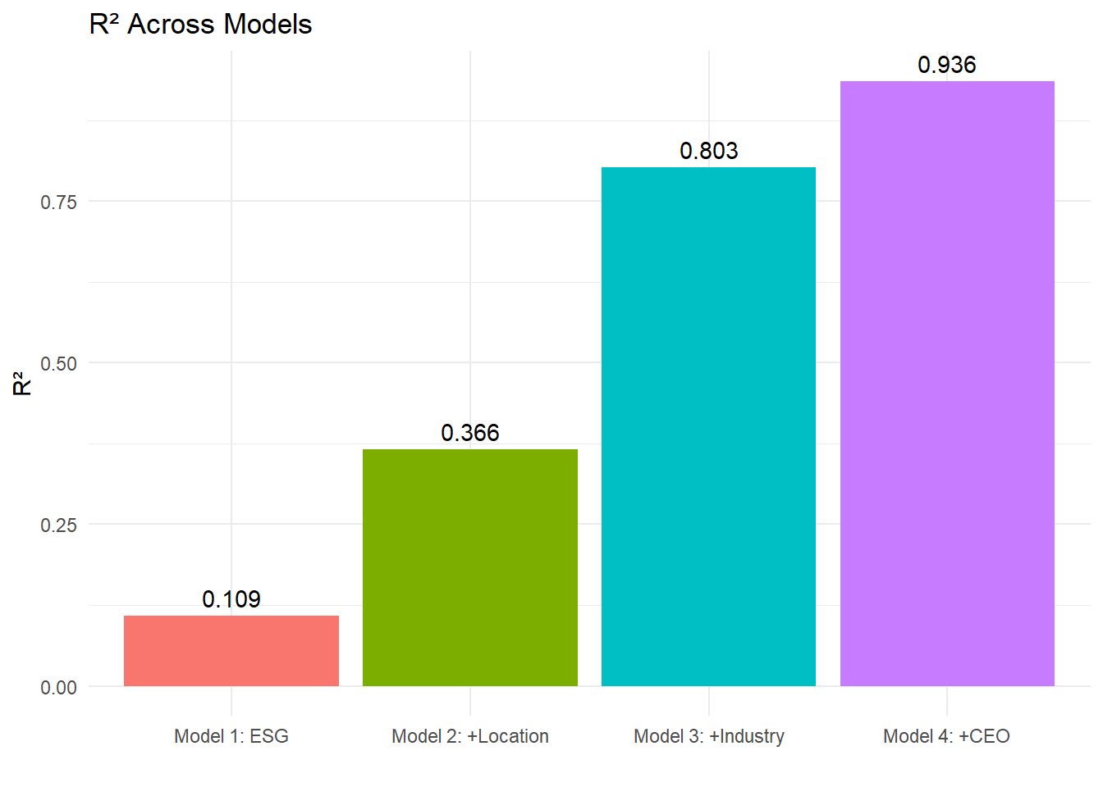
RoA Model
Model 1 – ESG Only: Variables: Carbon, Energy, ETOR → R² = 10.9% Limited explanatory power
Model 2 – ESG + Location: Adds city/state → R² = 36.6% Geographic context improves prediction
Model 3 – ESG + Location + Industry: Adds sector type → R² = 80.3% Sectoral dynamics play a major role
Model 4 – ESG + Location + Industry + CEO: Adds leadership identity → R² = 93.6% Leadership is a key differentiator

Slide 6
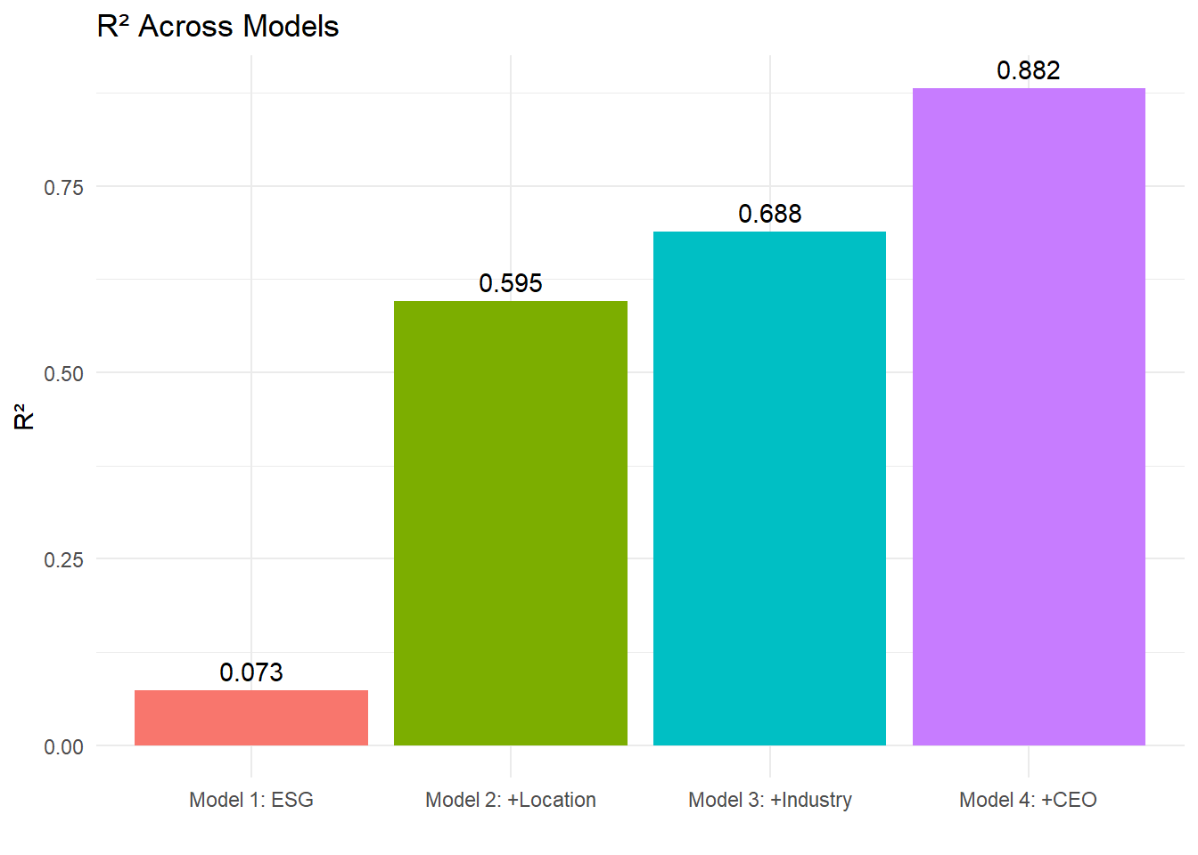
RoE Model
Model 1 – ESG Only: Variables: Carbon, Energy, ETOR → R² = 7.3% Minimal predictive strength
Model 2 – ESG + Location: Adds city/state → R² = 59.5% Location significantly boosts model
Model 3 – ESG + Location + Industry: Adds sector type → R² = 68.8% Consumer Goods sector stands out
Model 4 – ESG + Location + Industry + CEO: Adds leadership identity → R² = 88.2% CEO identity strongly influences equity returns

Slide 7
Key Insights
Companies that use more energy or have high employee turnover tend to perform worse financially.
Where a company is located—like Noida or Gurugram—can make a big difference in its results.
Who the CEO is really matters; leadership has a strong impact on performance.

Slide 8
Conclusion
ESG isn’t just about following rules—it can actually help a company grow.
Businesses that take ESG seriously are more likely to handle challenges and stay strong.
Using data to study ESG helps make smarter choices about where to invest and how to run the company better.

Slide 9
Thank You
About me:
http://srivathsanv.com/
Report:
IBA\ESG.pdf

